Slide 1


Structured Data Capture (SDC)
Population
Lloyd McKenzie | February 2025

Slide 2

Who am I?
Name: Lloyd McKenzie
Company: Dogwood Health
Background:
One of FHIR’s 3 initial editors
Co-chair FHIR-Infrastructure, past chair FHIR Management Group
HL7 Fellow
Lead for both the ONC and international FHIR SDC projects
lloyd@dogwoodhealthconsulting.com

Slide 3

This presentation
Can be downloaded from the Ontario Health e-Learning site:
https://elearning.ontariohealth.ca/login/index.php
Is licensed for use under the Creative Commons, specifically:
Creative Commons Attribution 3.0 Unported License
Do with it as you wish, so long as you give credit

Slide 4

Credit
These slides include content from Brian Postlethwaite
With updates by Lloyd McKenzie

Slide 5

The SDC Collection
SDC Overview
SDC Workflow
SDC Expressions (essential prerequisite)
SDC Rendering & Behavior
SDC Population (you are here)
SDC Extraction
SDC Adaptive Forms
SDC Modular & Derived Forms

Slide 6

Objectives
You should be able to:
Describe the benefits and challenges of form population
Summarize the workflow options for performing population
List the 4 pre-population mechanisms and explain the pros and cons of each
Explain the 3 modes of population, what they do, and when they apply
Be able to design questionnaires using both observation-based and FHIRPath-based population

Slide 7
SDC Population Outline
Population Overview
Observation-based
FHIRPath-based
StructureMap-based
Population Exercises
CQL

Slide 8
SDC Population Outline
Population Overview
Observation-based
FHIRPath-based
StructureMap-based
Population Exercises
CQL

Slide 9

Rationale for pre-population
Save time
Reduce transcription errors
Improve completeness
Improve currency

Slide 10
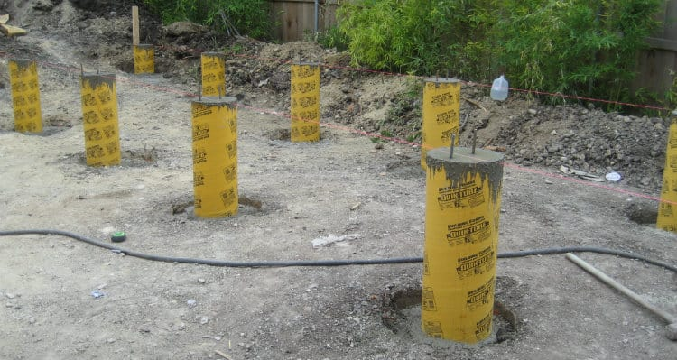
Population pre-requisites
Requires:
Context/source (FHIR)
Consistent profiles
Mapping
Processing engine
Knowledge of source structures (particularly profiled scope)

Slide 11
Population modes
1. First name: Lloyd
2. Last name: McKenzie
3. Gender: male
Full population
Choice selection
Answer context
24. Please list potentially relevant concomitant medications:
Atorvastatin
Tylenol
Current meds:
Amlodipine besylate
Atorvastatin
Hydrocortisone cream
Loratadine
37. Has the patient had similar procedures in the past?
Click to see list of past procedures

Slide 12

Population workflows
Local – initial only
Local – continuous
Remote - $populate
Remote - $populateHtml
Remote - $populateLink
Re-population?

Slide 13
Population workflows
Local – initial only
Local – continuous
Remote - $populate
Remote - $populateHtml
Remote - $populateLink
Re-population?
Works with all population approaches
May take longer before form is available to user
Less issues accessing data
Can’t leverage answers to questions as part of population
Doesn’t work well with choice selection/answer context
Provides a FHIR QuestionnaireResponse

Slide 14
Population workflows
Local – initial only
Local – continuous
Remote - $populate
Remote - $populateHtml
Remote - $populateLink
Re-population?
Can’t use StructureMap
Faster to initial form display
Less issues accessing data
Can leverage answers to questions as part of population
Only approach that works well with choice selection/answer context
Provides a FHIR QuestionnaireResponse

Slide 15
Population workflows
Local – initial only
Local – continuous
Remote - $populate
Remote - $populateHtml
Remote - $populateLink
Re-population?
Can use any approach
(that server supports)
Initial population only, but slower
Must pass token to allow data access beyond context resources
Doesn’t work well with choice selection/answer context
Provides a FHIR QuestionnaireResponse

Slide 16
Population workflows
Local – initial only
Local – continuous
Remote - $populate
Remote - $populateHtml
Remote - $populateLink
Re-population?
Can use any approach
(that server supports)
Initial population only, but slower
Must pass token to allow data access
Doesn’t work well with choice selection/answer context
Client must support HTML forms (and trust active content)
No QuestionnaireResponse

Slide 17
Population workflows
Local – initial only
Local – continuous
Remote - $populate
Remote - $populateHtml
Remote - $populateLink
Re-population?
Can use any approach
(that server supports)
In theory can do continuous population
Must pass token to allow data access
Minimal work for client
No QuestionnaireResponse

Slide 18
Population workflows
Local – initial only
Local – continuous
Remote - $populate
Remote - $populateHtml
Remote - $populateLink
Re-population?

Slide 19

Population data challenges
Data may not be discoverable
Data may be inconsistent
Data may not map easily to answer syntax
Data may change before submission
Data may be wrong
Notes:
Not coded, scanned faxes, not queriable
Inconsistent within a system or across systems
Different data types, different code systems

Slide 20

Other population challenges
Form filler needs data access – to everything?
Query load is potentially high
Possible lag in rendering form for entry
Maintaining population logic may be a lot of work
Queries should ideally filter to only what’s needed, but supported search params may not work well

Slide 21
Additional thoughts
Population doesn’t have to be patient-centric
Population can come from sources other than REST – e.g. IPS
Subject can change within the Questionnaire
Population does require a context of some sort
Sometimes you don’t want to populate even if there’s existing data
For initial population, it may make sense to populate elements that aren’t yet enabled
Use caution with populating read-only or hidden elements
Not all form fillers will support the same capabilities

Slide 22
Maintaining population metadata
Those who author the questions may not be best to add population metadata
Look at ‘form derivation’ to allow injecting metadata in a downstream step
See Derived & Modular forms module

Slide 23
Current population options
Observation-based
Or combination there-of
Can’t combine StructureMap-based
FHIRPath-based
StructureMap-based
CQL

Slide 24
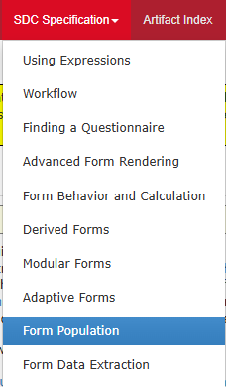
Population in the SDC Spec
Link

Slide 25
SDC Population Outline
Population Overview
Observation-based
FHIRPath-based
StructureMap-based
Population Exercises
CQL

Slide 26

Pre-population – Observation based
Low flexibility of Questionnaire structure in mapping
Source
Context may be provided in parameter, or SMART
Item.code for LOINC/SNOMED/other to search
Extension questionnaire-observationLinkPeriod to define range to check for last observation to read
Mapping
Item.code for LOINC/SNOMED/other for the values to be extracted from the observation
Groups can be used for extracting observation components
If the system understands that codings like LOINC 21112-8 is patient.birthDate, then it may extract data like this also
Notes:
Need to take care with DataElements as this is changing in R4

Slide 27
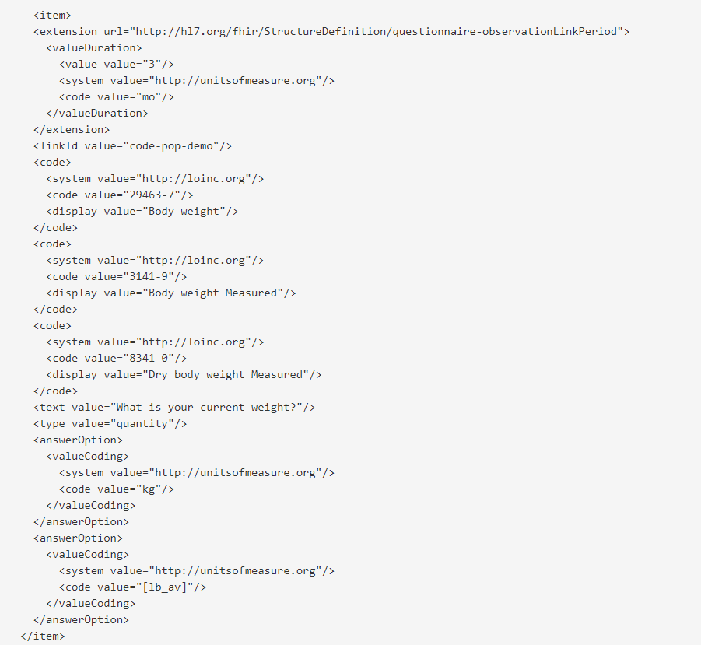
During the pre-population stage, this is the query that could be produced to extract the data:
(assuming that the date of 3 months ago was 2020-06-02)
[base]?Observation?subject=[questionnaire response subject id]
&code=http%3A//loinc.org|29463-7,http%3A//loinc.org|3141-9, http%3A//loinc.org|8341-0
&status=final
&date=ge2020-06-02
&_sort=-date
&_count=1

Slide 28
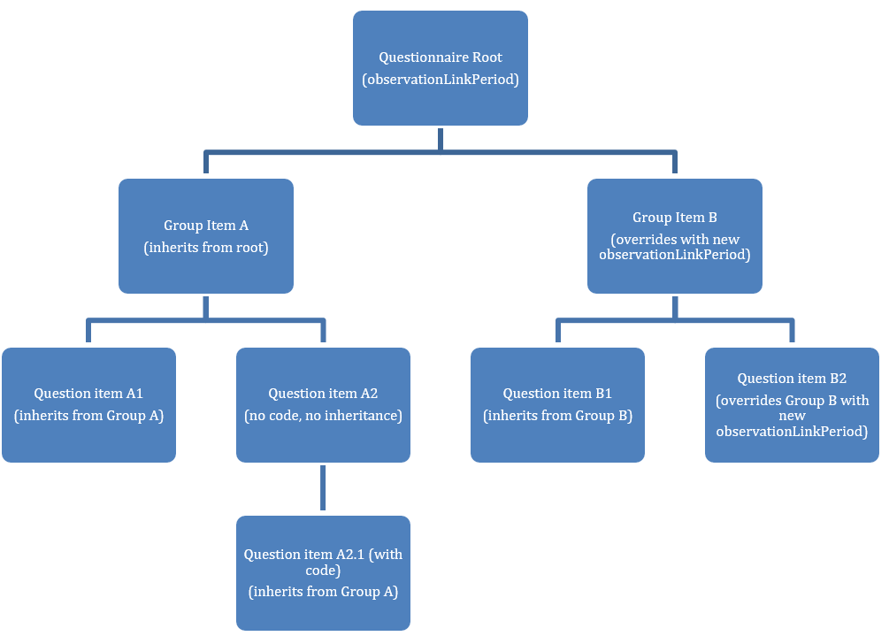

Slide 29
Observation-based considerations
Type conversion might be necessary
e.g. integer -> quantity
Unit conversion may be necessary
Observations might not have a value
Observation.status and focus must be checked
If a group item has a code, child questions can map to hasMember or components

Slide 30
Observation-based limitations
Only works for data in Observations
Only grabs most recent value
Doesn’t handle repeating items
For components, Questionnaire must have group with child questions mirroring Observation hierarchy
Doesn’t support Choice Selection or Answer Context modes
Can only support ‘continuous’ based on enable/disable, not on other elements

Slide 31
Let’s make one…
https://formbuilder.nlm.nih.gov

Slide 32
SDC Population Outline
Population Overview
Observation-based
FHIRPath-based
StructureMap-based
Population Exercises
CQL

Slide 33
Pre-population – FHIRPath based
Source
Context may be provided in parameter, or SMART
extension questionnaire-launchContext
x-fhir-query to access data not passed as context
Mapping
FHIR Path expressions for each property to map
extension “questionnaire-itemContext”
Extension “sdc-questionnaire-initialExpression”
Leverage variables to assist in calculations
Extension “variable” uses Expression datatype
More flexible, requires knowledge of FHIRPath and FHIR queries to create the mappings

Slide 34
Relevant FHIRPath extensions
Extension | Purpose
questionnaire-launchContext | Pass in %patient, %encounter, %user, etc. for use elsewhere
variable | Load data using x-fhir-query Perform calculations for use elsewhere Make answers available to descendant items
questionnaire-itemPopulationContext | For repeating questions and groups, establish an element as context for each repetition
questionnaire-initialExpression | Set the actual value for the element

Slide 35
Other modes
In addition to initialExpression, can use:
sdc-questionnaire-valueExpression
for choice selection
sdc-questionnaire-contextExpression
for answer context

Slide 36
What does it look like?
https://build.fhir.org/ig/HL7/sdc/Questionnaire-questionnaire-sdc-test-fhirpath-prepop-candexpr.json.html

Slide 37
FHIRPath-based considerations
FHIRPaths may need to be complex
Handle data variation
Handle data filtering (check status, modifiers, etc.)
Sibling elements aren’t visible to FHIRPath
Use variable on a common ancestor
Limited type conversion is possible:
Resource -> Reference
Quantity -> integer or decimal
Code -> Coding

Slide 38
Dynamic population
Population expressions may depend on answers
Other expressions may depend on those expressions
I.e., a cascade of updates are possible
What elements are in scope changes as elements are enabled/disabled
If a user has changed a value from an initialValue, it shouldn’t be changed
I.e., – it gets complicated ☺

Slide 39
FHIRPath-based Limitations
Cannot do dynamic population
Can’t execute ConceptMaps
unless engine supports %terminology.translate()
Struggles to perform complex data transformations

Slide 40
Testing population
https://fhirpath-lab.com/Questionnaire/tester

Slide 41
SDC Population Outline
Population Overview
Observation-based
FHIRPath-based
StructureMap-based
Population Exercises
CQL

Slide 42
Pre-population – StructureMap based
Source
Batch Bundle of SearchResult Bundles
Produced by running sdc-questionnaire-sourceQueries
Queries may be x-fhir-queries that could use questionnaire-launchContext
Mapping
StructureMap that converts the Batch Bundle of search Bundles to a QuestionnaireResponse
Very powerful, requires knowledge of FHIR Queries and StructureMap

Slide 43
Pros and cons
Pros
Can map almost anything
StructureMaps can build from other StructureMaps
Can validate ‘correctness’ without instances
Cons
Only for initial population
Can’t be used for Choice Selection or Answer Context modes
Queries are run once and can’t be interdependent
If the StructureMap fails, there won’t be any population at all

Slide 44
Example StructureMap-pop Questionnaire
https://build.fhir.org/ig/HL7/sdc/Questionnaire-questionnaire-sdc-test-fhirpath-prepop-source-query.json.html
Map: https://build.fhir.org/ig/HL7/sdc/StructureMap-QuestionnairePopulationTransform.html

Slide 45
SDC Population Outline
Population Overview
Observation-based
FHIRPath-based
StructureMap-based
Population Exercises
CQL

Slide 46
Pre-population – CQL
NOTE: Not (yet) defined in SDC
Source
Context may be provided in parameter, or SMART
extension questionnaire-launchContext
Data queried directly by CQL
Mapping
CQL expressions for each property to map
extension “questionnaire-itemContext”
Extension “sdc-questionnaire-initialExpression”
Most flexible, requires knowledge of CQL and FHIR Queries to create the mappings
Will typically involve external libraries

Slide 47
Pros and cons
Most capable of all mechanisms
Can invoke operations (such as code translation)
Can perform queries in response to updates
Can include complex algorithms and transformations
Can use Libraries to support code re-use
Syntax agnostic and platform-agnostic
Requires use of a language not many are familiar with

Slide 48
CQL notes
CQL isn’t formally discussed in SDC
In theory, it’s covered under the expression-based approach
Differences in approach
Don’t need x-fhir-query to retrieve data
Don’t need ‘variable’ extensions to hold onto shared data
Can perform code translation, unit conversion, etc. on-the-fly
Code is typically managed in a separate library, not in-line in the extensions
Extensions just point to defined identifiers in the CQL library

Slide 49
Relevant CQL extensions
Extension | Purpose
questionnaire-launchContext | Pass in %patient, %encounter, %user, etc. for use within the library
questionnaire-itemPopulationContext | For repeating questions and groups, establish an element as context for each repetition
questionnaire-initialExpression | Set the actual value for the element (usually just a reference to a CQL identifier)
Can still use sdc-questionnaire-valueExpression and sdc-questionnaire-contextExpression for choice selection and answer context

Slide 50
CQL example
Questionnaire: https://build.fhir.org/ig/cqframework/cqf-us/Questionnaire-MNACQuestionnaire.json.html
Library: https://build.fhir.org/ig/cqframework/cqf-us/Library-MNACInitialExpressions.html

Slide 51
SDC Population Outline
Population Overview
Observation-based
FHIRPath-based
StructureMap-based
Population Exercises
CQL

Slide 52
Population Exercise
Create a Questionnaire that uses a combination of observation-based and FHIRPath-based population that includes questions for the following:
Patient’s birth date
Patient’s parent names
Patient’s most recent body weight

Slide 53
The SDC Collection
SDC Overview
SDC Workflow
SDC Expressions (essential prerequisite)
SDC Rendering & Behavior
SDC Population (you are here)
SDC Extraction
SDC Adaptive Forms
SDC Modular & Derived Forms

Slide 54



Questions / Discussion
lloyd@dogwoodhealthconsulting.com http://hl7.org/fhir/uv/sdc
Or, better yet, include the community and ask/discuss on https://chat.fhir.org/#narrow/channel/179255-questionnaire

